Slide 1

EEC-201 Final Project:
Speaker Recognition
Team

Slide 2
Topics
Speech Feature Extraction
Speech Feature Matching
Detection Performance
Demonstration

Slide 3
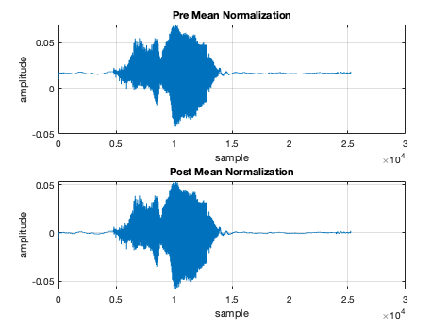
Signal Mean Normalization
Used mean normalization on input signals to remove DC offsets
Example: s09.wav has a DC offset
The DC offset is removed after mean normalization

Slide 4
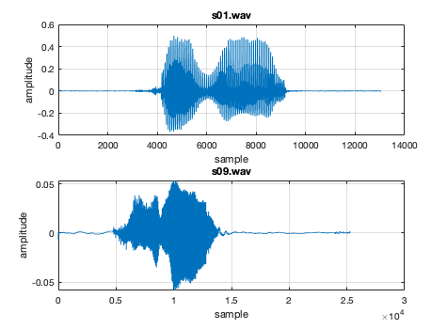
Signal Amplitude Scaling
Some speakers speak louder, other speak quietly
Example: s01.wav vs s09.wav
Scaled signal amplitudes to -1:1 range for all speakers to remove word detection sensitivity to signal amplitude

Slide 5
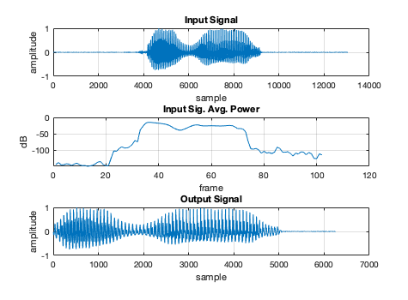
Word Detection
Signals contain quiet parts and a part that contains the spoken word
Power threshold detection was used to determine the start of the word
Split signal into multiple segments and estimated the PSD of each segment
If the average power of the frame is over a threshold, the the start of the word is detected
Used a threshold of -45 dB
A determined amount of time was used to extract the word segment of the signal
Some speakers speak longer than others
The mean time it took for the speaker to say the word was 500 ms (6250 samples at 12.5 kHz sampling rate)

Slide 6
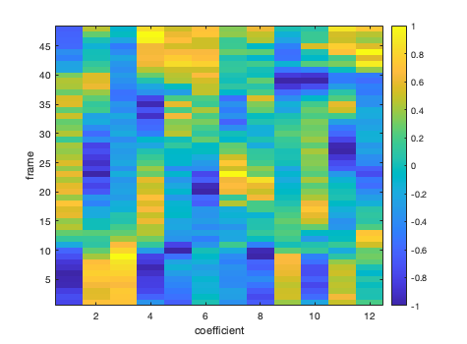
Mel Frequency Cepstrum Coefficients (MFCC)
Short-Time Fourier Transform (STFT)
Mel-Spaced Filter Banks
Cepstrum
Normalization

Slide 7
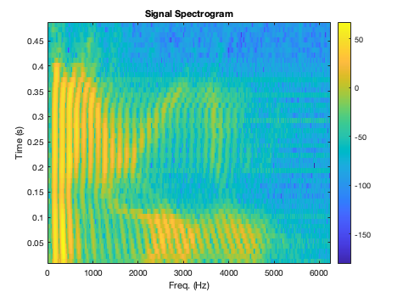
STFT
Split each signal into multiple windows
Each window should capture a part of the word that is quasi-stationary
We used 25 ms window with 15 ms overlap
Do DFT on each window do estimate the PSD of the frame
Shows the frequency components of parts of the words

Slide 8
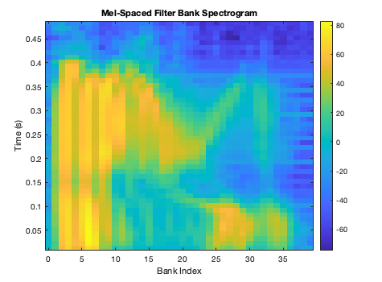
Mel-Spaced Filter Banks
Models how humans perceive sounds
We used 40 banks for a finer frequency resolution
The STFT output is multiplied with the mel-spaced filter banks to effectively filter the signals through the filter banks

Slide 9
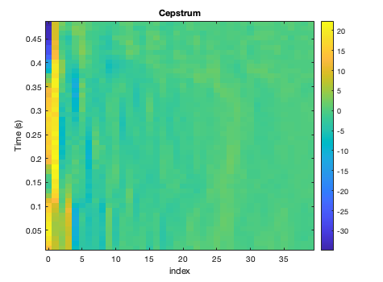
Cepstrum
The output of the Mel-spaced filter banks is passed through cepstrum to convert the signal spectra back to time domain
Most of the energy is contained in the lower coefficients
Only a selected range of the cepstrum coefficients are used for MFCC
We used coefficients 2 - 14

Slide 10
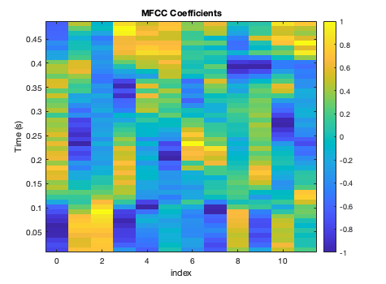
Coefficient Normalization
Some coefficients have outliers that skew the points in a certain direction
Mean normalization was used to reduce the skew of the outliers
The cepstrum coefficient amplitudes vary greatly
L = Inf norm was used to limit the range of the coefficients between -1 and 1

Slide 11
Topics
Speech Feature Extraction
Speech Feature Matching
Detection Performance
Demonstration

Slide 12
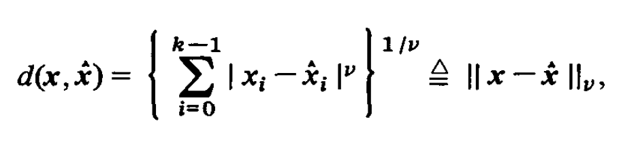
Feature Matching: Linde Buzo Gray
The Linde Buzo Gray (LBG) algorithm for Vector Quantization (VQ) was implemented for speaker recognition.
Key aspects of this algorithm:
Use of codebooks comprised of codewords
“Learns” data by minimizing distortion
Used the Euclidean distance for distortion
k-clustering
Key parameters of this algorithm:
Codeword count
Limited to powers of 2
Dimension count
Distortion change threshold

Slide 13
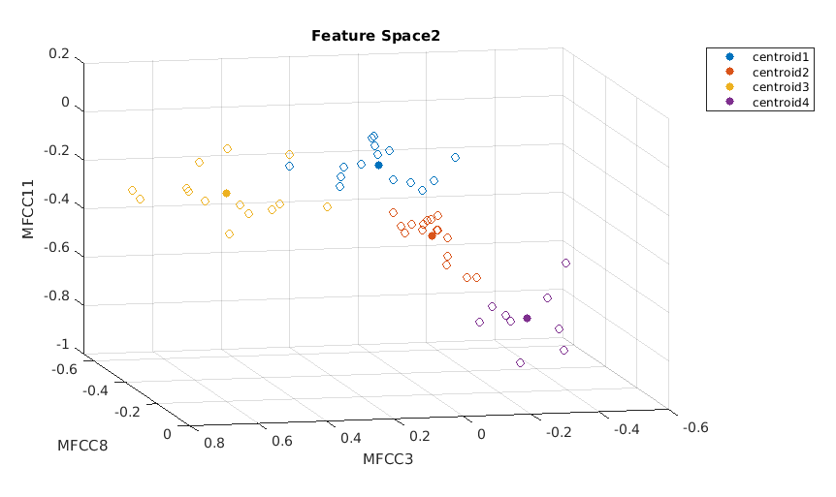
Feature Matching: Linde Buzo Gray
A codebook set to learn 4 codewords which are also referred to as centroids.
Depicts how the LBG VQ algorithm learned “learned” MFCC11, MFCC8 and MFCC3 for a codebook, and also how the MFCC data overtime was clustered with each centroid.

Slide 14
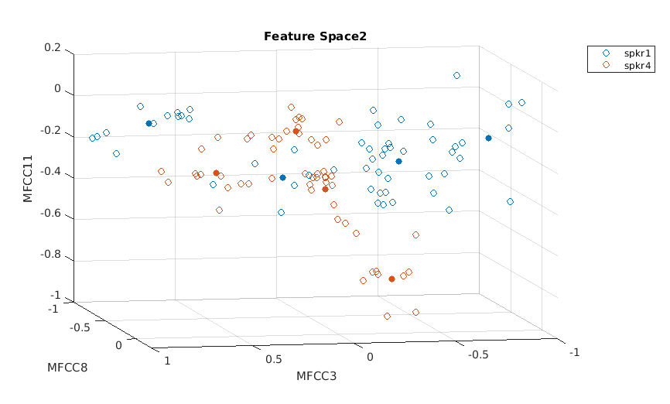
Feature Matching: Linde Buzo Gray
Speaker1 and Speaker4’s codebooks plotted in 3 dimensions as MFCC3, MFCC8 and MFCC11.
This image depicts how each speaker’s MFCCs may be unique and enable speaker recognition.

Slide 15
Feature Matching: Speaker Recognition
Speaker recognition follows a similar process to the training phase:
Test new data against all trained codebooks
Evaluate the total distortion of training data to each codebook’s centroids
The codebook with minimum total distortion is the likely speaker.
However, there is a little more to providing accurate recognition results.

Slide 16
Feature Matching: Speaker Recognition
We need some confidence in our recognition decision.
This may be accomplished a couple of ways:
Set a threshold of no-confidence
Speaker distortion vector normalized by max total distortion
Un-Recognized speakers must not exceed threshold
Balance between missed recognition and false recognition
Provide a confidence factor on the decision
Confidence factor determined analyzing total distortion of all codebooks compared to average
Decision may be made based on recognition confidence level
We Implemented a threshold of no-confidence

Slide 17
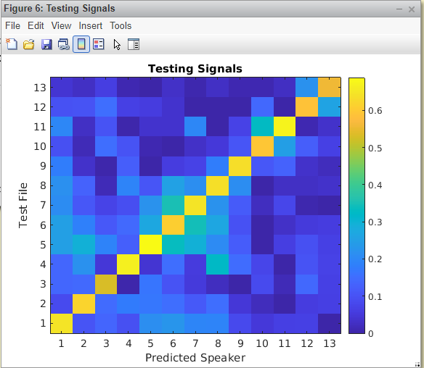
Feature Matching: Speaker Recognition
We plotted each test speaker’s total distortion evaluated with each codebook.
As expected, our system predicts the right speaker for each test vector, producing an x=y style plot.
The L-infinity norm dramatically reduces incorrection speakers probability, due to much higher distortion in at least one of the MFCCs.

Slide 18
Topics
Speech Feature Extraction
Speech Feature Matching
Detection Performance
Demonstration

Slide 19
Detection Performance: Degraded SNR
SNR | Prediction Threshold | Accuracy
18 | 0.25 | 100%
15 | 0.25 | 100%
12 | 0.25 | 72%
12 | 0.15 | 90%
9 | 0.25 | 63%
9 | 0.15 | 81%

Slide 20
Detection Performance: Mel Filter Notch
When testing files which have had a single Mel-Frequency filter bank notched out, we saw no effect on our prediction system.
Maintained 100% accuracy over the 11 test files.

Slide 21
Demo

